Slide 1
Math 170 Functions, Data, and Models
22 Function Transformations
Section 6.1-5

Slide 2
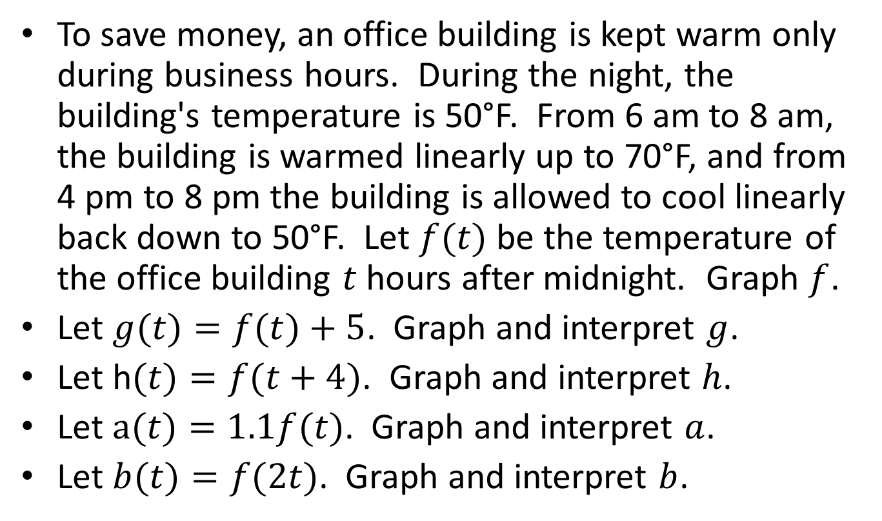
Office Building Example
To save money, an office building is kept warm only during business hours. During the night, the building's temperature is 50°F. From 6 am to 8 am, the building is warmed linearly up to 70°F, and from 4 pm to 8 pm the building is allowed to cool linearly back down to 50°F. Let $f(t)$ be the temperature of the office building $t$ hours after midnight. Graph $f$.
Let $g(t)=f(t)+5$. Graph and interpret $g$.
Let h$(t)=f(t+4)$. Graph and interpret $h$.
Let $a(t)=1.1f(t)$. Graph and interpret $a$.
Let $b(t)=f(2t)$. Graph and interpret $b$.

Slide 3
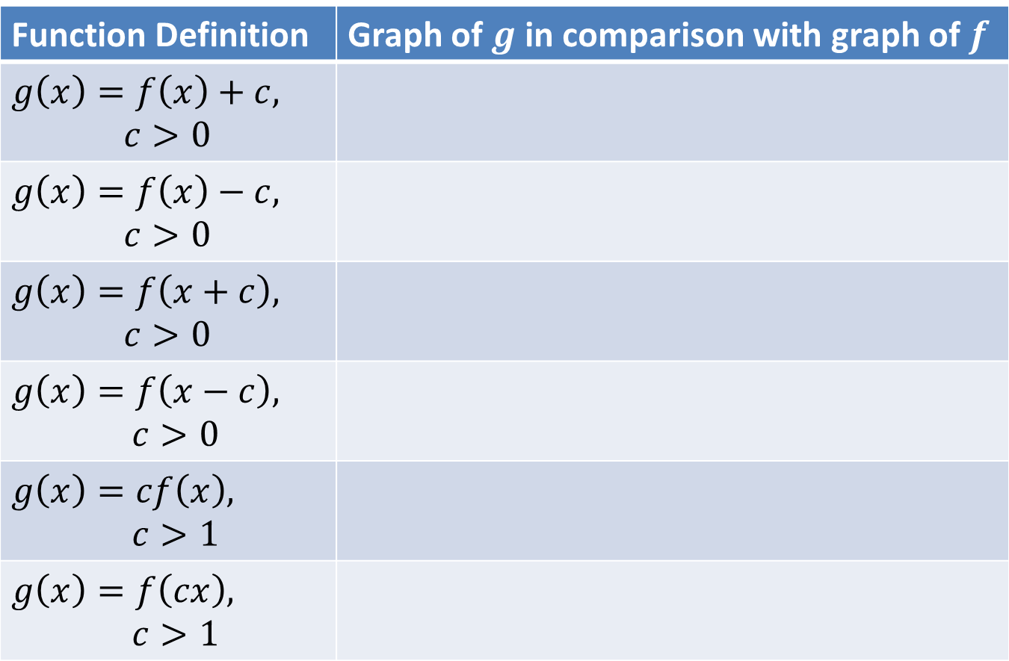
First Summary
Function Definition | Graph of in comparison with graph of

Slide 4
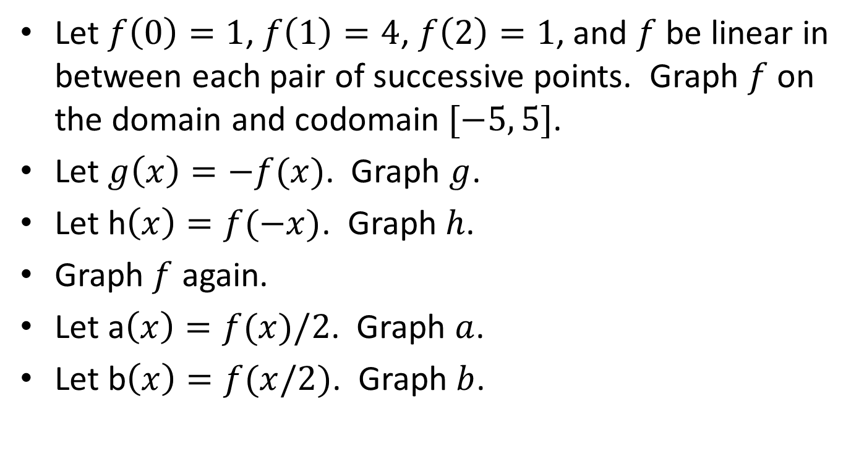
Pulse Example
Let $f\left(0\right)=1$, $f\left(1\right)=4$, $f\left(2\right)=1$, and $f$ be linear in between each pair of successive points. Graph $f$ on the domain and codomain $[−5, 5]$.
Let $g\left(x\right)=−f(x)$. Graph $g$.
Let h$\left(x\right)=f(−x)$. Graph $h$.
Graph $f$ again.
Let a$\left(x\right)=f(x)/2$. Graph $a$.
Let b$\left(x\right)=f(x/2)$. Graph $b$.

Slide 5
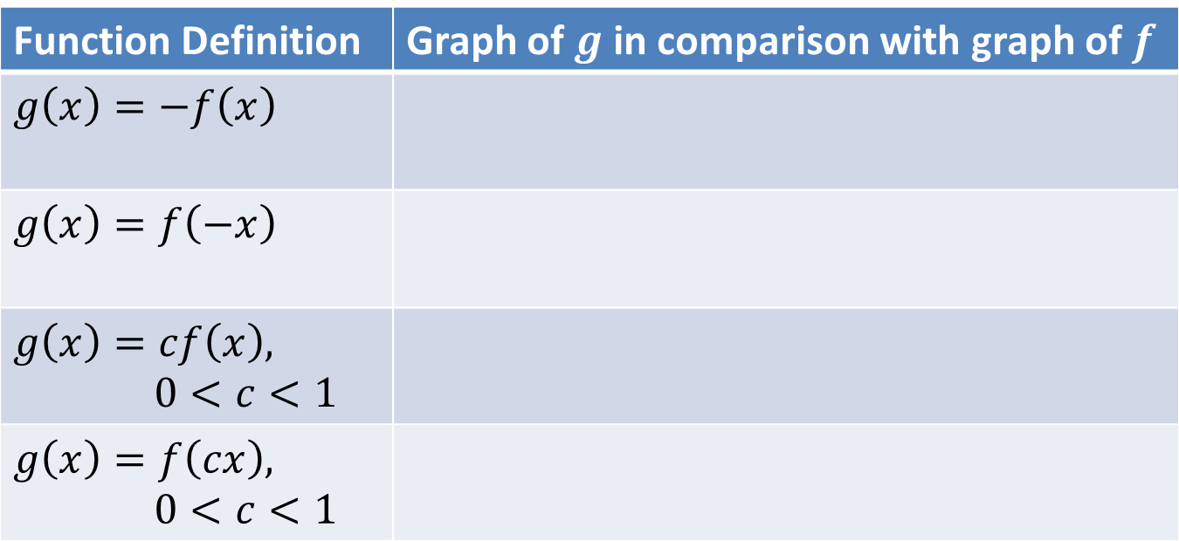
Second Summary
Function Definition | Graph of in comparison with graph of

Slide 6
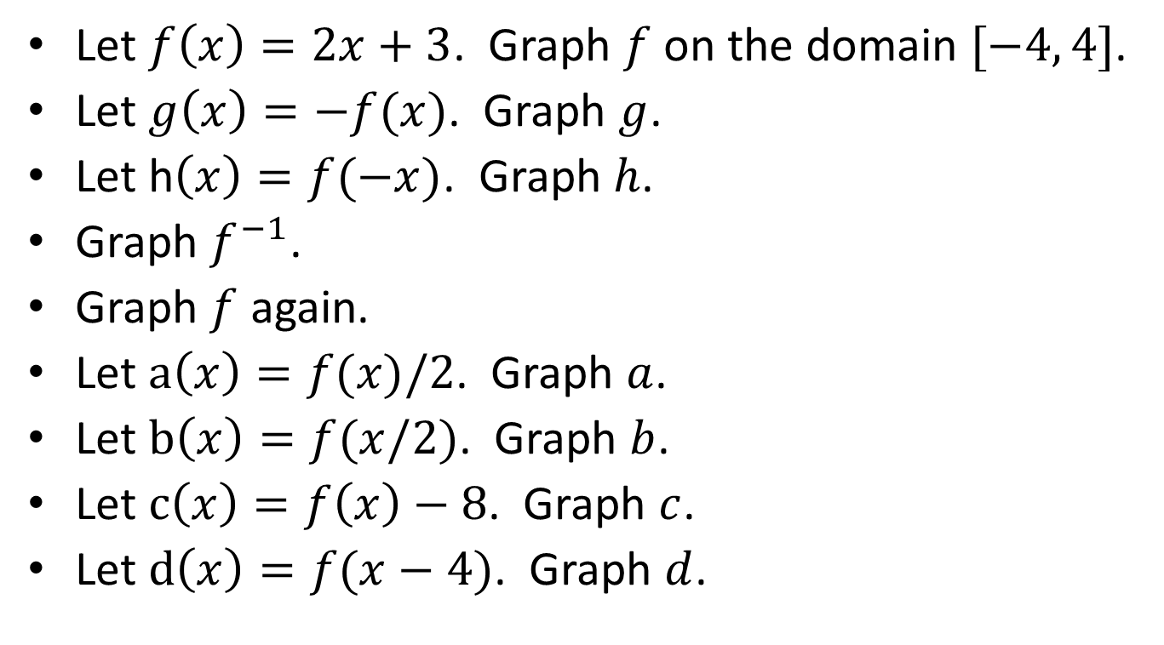
Straight Line Example
Let . Graph on the domain .
Let . Graph .
Let h. Graph .
Graph .
Graph again.
Let . Graph .
Let . Graph .
Let . Graph .
Let . Graph .

Slide 7
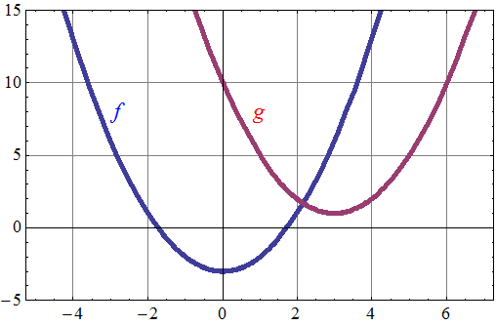
From the graph, define in terms of .
Verify with the formulas and .

Slide 8
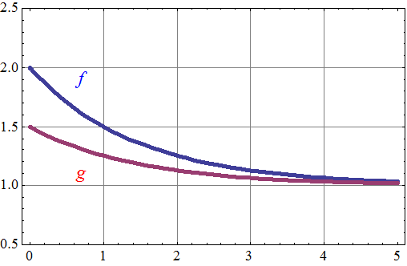
These are graphs of $f\left(x\right)=2^{−x}+1$ and $g\left(x\right)=2^{−(x+1)}+1$. How are the graphs related?

Slide 9
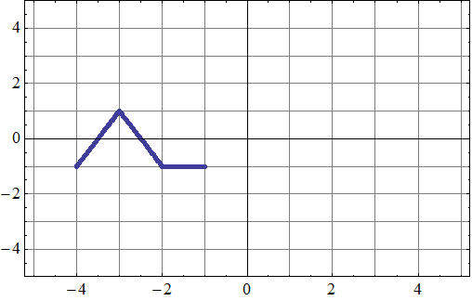
Let $f$ be defined by the graph.
Let $h\left(x\right)=−4f\left(x−5\right)−1$. Graph $h$.

Slide 10
Example 1. Let $f\left(x\right)=x^{2}$, $g\left(x\right)=−f(x)$, and $h\left(x\right)=g\left(x\right)+1$. Graph and find formulas for $f$, $g$, and $h$.
Example 2. Let $f\left(x\right)=x^{2}$, $g\left(x\right)=f\left(x\right)+1$, and $h\left(x\right)=−g\left(x\right)$. Graph and find formulas for $f$, $g$, and $h$.
How are the two examples related?

Slide 11
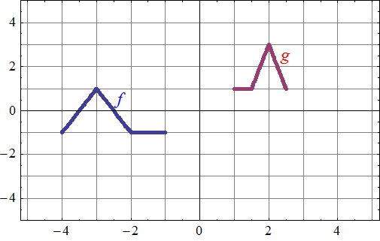
Let $f$ and $g$ be defined by the graphs.
Define $g$ in terms of $f$.

Slide 12
Sample problem
Suppose a lake has a depth of 50 feet, but due to drought conditions the depth has ben decreasing at a rate of 12% per month. Let $d(t)$ be the depth of the lake after $t$ months.
Find a formula for $d$ and sketch a graph of $d$.
Let $f(t)$ be the distance from the original waterline down to the surface of the lake.
Find a formula for $f$ and sketch a graph of $f$.
Describe the transformations to get from $d$ to $f$.

